Slide 1
(EDL manuscript) Time-step-free Physics-Based Modeling of Retention Loss in Cryogenic 3-D NAND Flash 연구 요약 진명

Slide 2
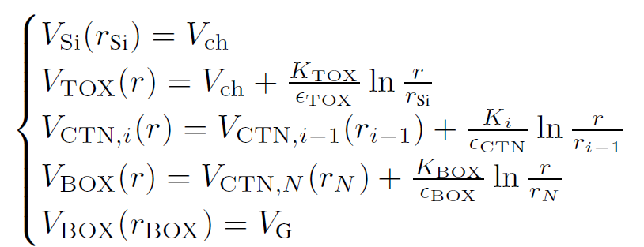
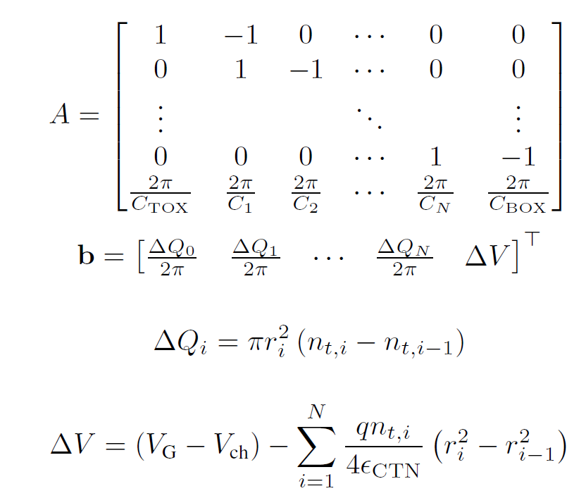



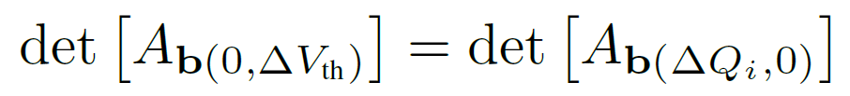
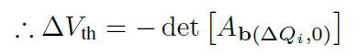
Detailed Poisson Solution / Q-ΔV_{th} Relation
Potential Solution: Poisson equation
Boundary conditions
Solution
Q-ΔV_{th} Relation
>> computation optimization
ΔV_{th} calculation can be done with
single determinant

Slide 3
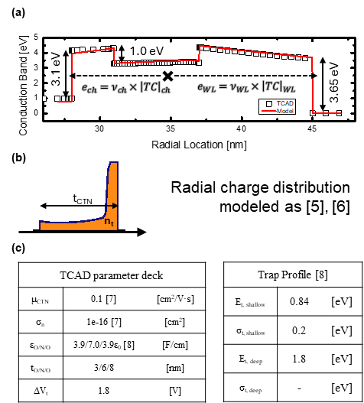
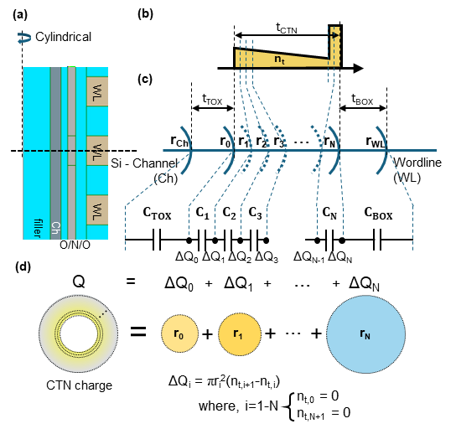
Visualization & Parameters

Slide 4
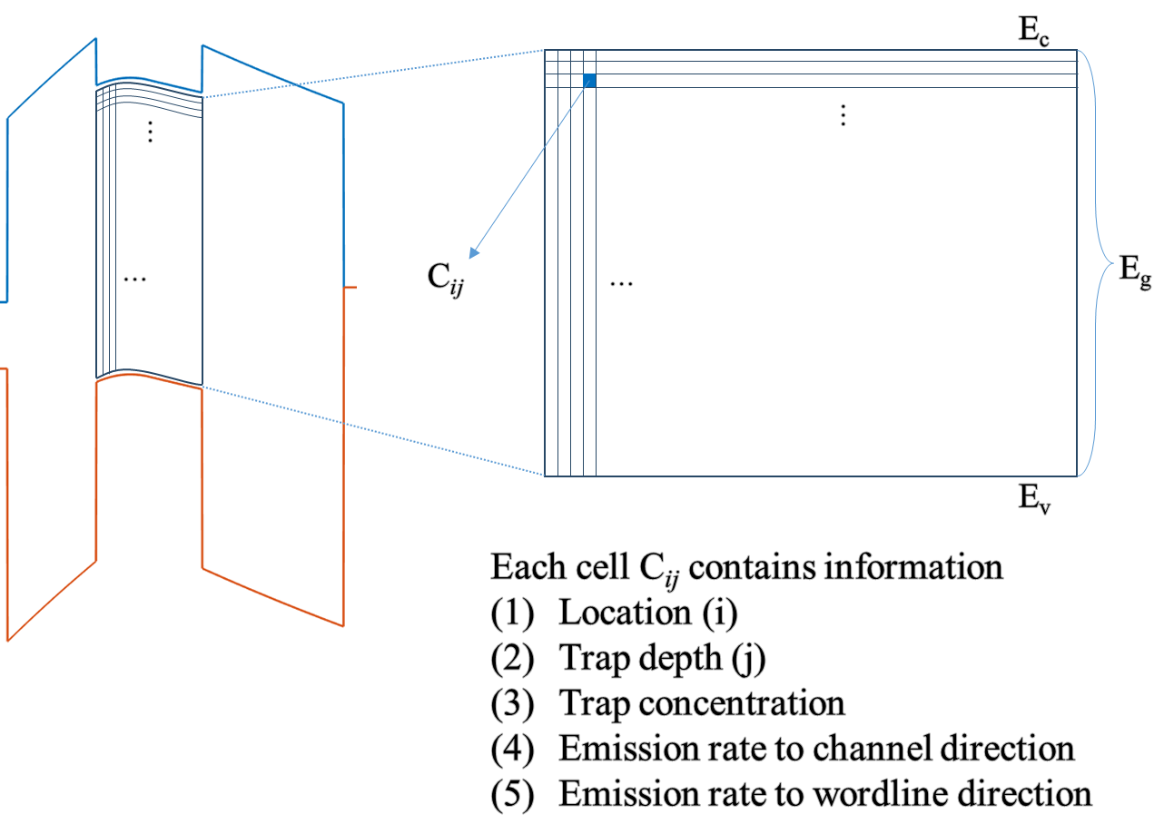
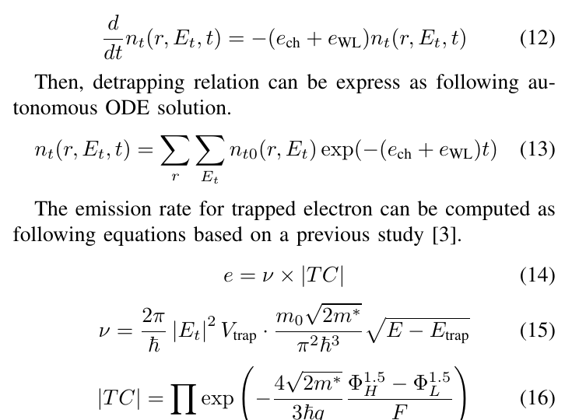
Time-step-free Physics-based Modeling
1. Initial state
n_{t0}(r, E_{t})
Initial state definition
2. Emission rates
e_{ch}, e_{WL}
Emission evaluation
Jin, IEEE TED (2025)
3. Direct evaluation
n_{t}(r, E_{t}, t)

Slide 5
Cryogenic Calibration
Measurement (Refaldi, IRPS 2025)
Measurement – TCAD calibration
model – TCAD match
t_{TOX}
= 3, 3.5, 4, 4.5, 5 [nm]
TCAD cryogenic: σ → 0 cm²
O/N/O = 3/6/8
t_{TOX} = 3 ~ 5 [nm]

Slide 6
Computational Impact
Property
Transient TCAD
Time-step-free model
Temporal
treatment
Sequential
time stepping
Closed-form
evaluation of Eq. (13)
Final-time
dependence
Runtime grows as
simulated retention time increases
Independent of final
physical time for fixed queries
Average
runtime
27483 s
3.926 s
≈ 7000×
runtime reduction
TCAD 는 final physical time까지 time step 별 순차적으로 계산
Time-step-free model은 closed-form evaluation
Computational resource는 final retention time 자체가 아니라 trap bin 수와 evaluated time point 수에 의해 결정

